Slide 1

Final Year Project Phase 1
Sardar Patel Institute of Technology
Electronics and Telecommunication Department
A project under the guidance of
Dr. Preetida V. Jani
Group Number 4
Ruman Kazi
Ameya Nambisan
Simran Tiwari

Slide 2
Morphius
A Self-reconfiguring modular robot that navigates through cracks and debris for inspection

Slide 3
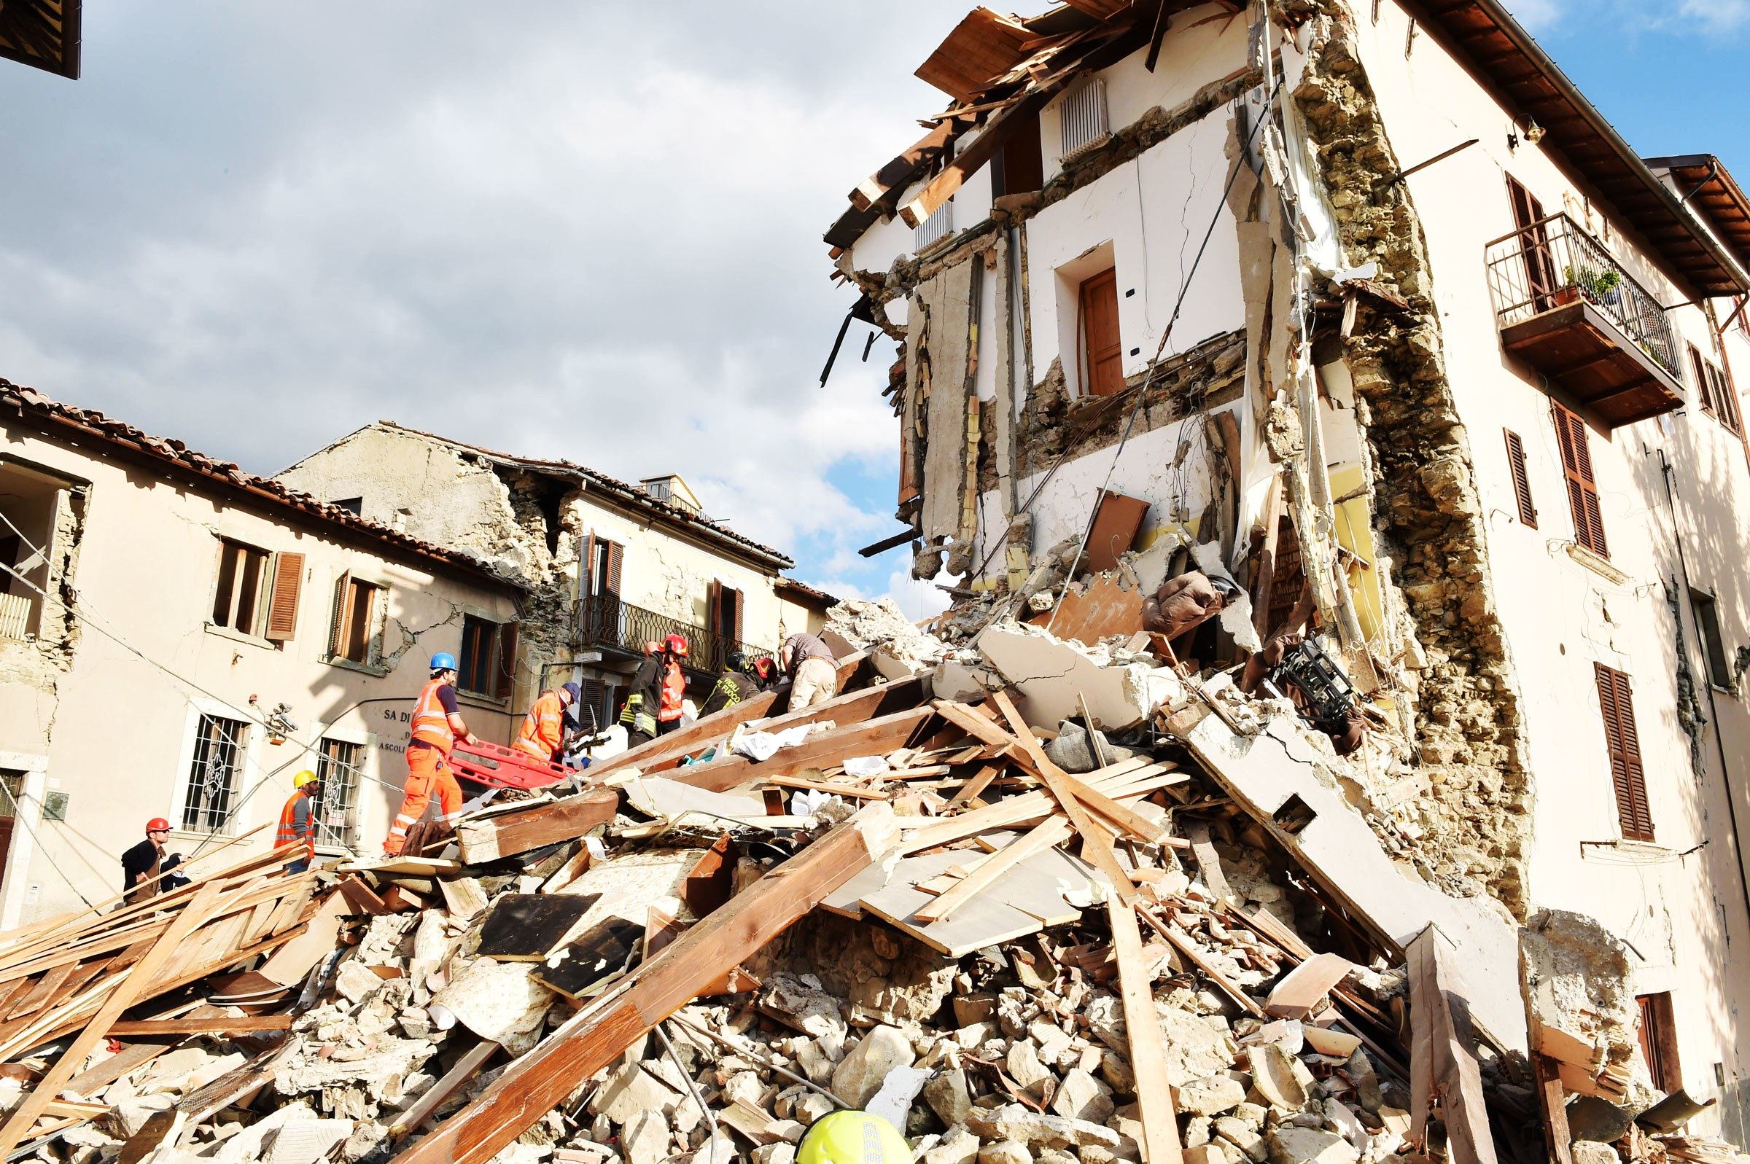
Motivation
Conventional methods used in rescue operations - human rescuers and dogs
Development of robot that can traverse through such environment and provide assistance can speed up the rescue operations.
Modular Robotic System (MRS) have been proven to work better in such conditions.
Notes:
fall increasingly short of being able to meet the complex requirements posed by such events.
They should - navigate complex and collapsed structures, find victims, and generate human readable maps of the environment. The randomness of the complexity of such terrains make it difficult to deploy generic robots.
Developing a Modular Robotic System (MRS) with heterogeneous modules gives more flexibility and increases the reachability of rescue operations.

Slide 4
Problem Statement
Use of modular robots for rescue operations involve constraints on parameters such as speed, size, shape of robot, locomotion mechanisms, etc. This requires development and design of a MRS that optimizes the above parameters. The use of heterogeneous modules capable of self-reconfiguration improves speed of locomotion and resourcefulness at the cost of simplicity.

Slide 5
Morphius - A Modular Robotic System
M - Module | Self-reconfigurable, Heterogeneous
I - Information | Real-Time Data collection & Wireless communication
T - Task | Variable Morphology, Navigation, Exploration & Inspection
E - Environment | Ground based bounded workspace

Slide 6
Objectives
Design of Modular Robotic System (MRS)
Inter-module connection Mechanism
Wireless Communication
Determining the best possible path and configuration
Improving the speed of MRS

Slide 7
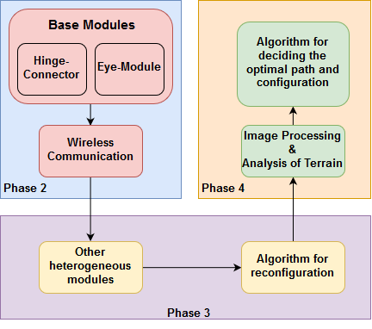
Planning
These are necessary for every module.
Hinge-connector module
Eye-module
Wireless Communication
Other heterogeneous modules having connectable faces
Algorithm for reconfiguration
Image processing for mapping terrain
Decision making capability

Slide 8
Hardware
Software
Raspberry Pi Zero
Infrared sensor
Camera
Servo and DC motors
ESP32/ESP8266
Arduino Nano
HM-10 Bluetooth 4.0
Python Shell
AutoCAD Fusion 360
Coppelia Robotics V-REP Simulator
Arduino IDE
Code Composer Studio

Slide 9
Literature Survey
Topic | Papers/Reports/Books | Summary
Basic terminology, concepts related to Modular Robotic Systems | Modular Robotic Systems: Characteristics and Applications - A detailed report[1] | Terminology, classifications and various parameters related to Modular robotic system will be followed from these papers. The four fundamental components of Module, Information, Task, and Environment (shortly, M-I-T-E) will help us describing our MRS
 | Self-Reconfigurable Robots: An Introduction[2]

Slide 10
Topic | Papers/Reports/Books | Summary
Existing MRS | Distributed Self-Reconfiguration of M-TRAN III Modular Robotic System[3] | Already existing MRS having different types of designs and mechanisms. Each type has some advantages and disadvantages compared to others. We will be selecting the features, designs and mechanisms the most suitable for our system and application through these papers.
 | Emulating Self-reconfigurable Robots - Design of the SMORES System[4]
 | A New Self-Reconfigurable Modular Robotic System UBot: Multi-mode locomotion and Self-reconfiguration[5]
 | Design of a Modular Mobile Multi Robot System: ULGEN (Universal-Generative Robot)[6]
 | SQ-BOT - a modular robot prototype for self-reconfiguring structures[7]

Slide 11
Topic | Papers/Reports/Books | Summary
Homogeneous v/s Heterogeneous modules | Motion planning for heterogeneous modular mobile systems[8] | The papers present a metamorphic robot which is self-sufficient and with relatively homogeneous module that can be connected to other modules to form complex robots. The absence of heterogeneity puts a constraint on the number of unique configurations available. Introducing heterogeneity, although is of public interest, creates reconfiguration problem. Feasible algorithms are proposed to tackle the same.
 | CONRO: Towards Deployable Robots with Inter-Robots Metamorphic Capabilities[9]
 | Reconfiguration Planning for Heterogeneous Self-Reconfiguring Robots[10]
 | Adaptive Reconfiguration of a Modular Robot through Heterogeneous Inter-Module Connections[11]

Slide 12
Topic | Papers/Reports/Books | Summary
Algorithms for reconfiguration, communication,decision making and learning | Automatic Configuration Recognition Methods in Modular Robots[12] | Robots should be able to process information from distributed sensors to form a global situation assessment, detecting and selecting a better configuration when needed, and determining a sequence of actions to perform the transformation. They discuss the use of deep Q network for mobile robot path planning and recognition of configuration.
 | Application of Deep Reinforcement Learning in Mobile Robot Path Planning[13]
 | Heavy-duty connectors for self-reconfiguring robots[14]

Slide 13
Topic | Papers/Reports/Books | Summary
Motion Planning | A Substructure Based Motion Planning Method for a Modular Self-reconfigurable Robot[15] | Different methods, algorithms and mechanisms available for motion planning of heterogeneous and homogeneous modular robots have been discussed here. Also the important metrics to be considered while planning a strategy for motion of modular robots are explored.
 | A Motion Planning Method for a Self-Reconfigurable Modular Robot[16]
 | Research on Mechanism Design and Motion Planning of a Modular Self-reconfiguring Robot[17]
 | Useful metrics for modular robot motion planning[18]
 | Study on motion planning strategy of a modular self-reconfigurable robot[19]

Slide 14
References
[1] H. Ahmadzadeh, E. Masehian and M. Asadpour, "Modular Robotic Systems: Characteristics and Applications", Springer, Dordrecht, 2015.
[2] Stoy, Kasper & Brandt, David & Christensen, David. (2010). Self-Reconfigurable Robots: An Introduction.
[3] Haruhisa Kurokawa,Kohji Tomita, Akiya Kamimura, Shigeru Kokaji, Takashi Hasuo,Satoshi Murata , "Distributed Self-Reconfiguration of M-TRAN III Modular Robotic System ," in International Journal of Robotics March 2008
[4] Jay Davey, Ngai Kwok and Mark Yim, "Emulating Self-reconfigurable Robots - Design of the SMORES System " in 2012 IEEE/RSJ International Conference on Intelligent Robots and Systems
[5] Jie Zhao, Xindan Cui, Yanhe Zhu, et al. “A new self-reconfigurable modular robotic system UBot: Multi-mode locomotion and self-reconfiguration,” IEEE International Conference on Robotics and Automation. Piscataway, NJ, USA , pp. 1020-1025, 2011.
[6] H. Ercan and P. Boyraz, "Design of a Modular Mobile Multi Robot System: ULGEN (Universal-Generative Robot)", IEEE Xplore, 2016.

Slide 15
[7] C. S. S. Reddy, S. patlolla, A. Agrawal and K. R. Anupama, "SQ-BOT - a modular robot prototype for self-reconfiguring structures," 2016 International Conference on Robotics: Current Trends and Future Challenges (RCTFC), Thanjavur, 2016, pp. 1-6.
[8] S. Chitta and J. R. Ostrowski, "Motion planning for heterogeneous modular mobile systems," Proceedings 2002 IEEE International Conference on Robotics and Automation (Cat. No.02CH37292), Washington, DC, USA, 2002, pp. 4077-4082 vol.4
[9] Andres Castano Wei-Min Shen Peter Will, "CONRO: Towards Deployable Robots with Inter-Robots Metamorphic Capabilities, " in Autonomous Robots June 2000, Volume 8, Issue 3, pp 309–324
[10] R. Fitch, Z. Butler, D. Rus, "Reconfiguration planning for heterogeneous self-reconfiguring robots, " in 2003 IEEE/RSJ International Conference on Intelligent Robots and Systems (IROS 2003)
[11] Shimizu, T. Kato, M. Lungarella and A. Ishiguro, "Adaptive Reconfiguration of a Modular Robot through Heterogeneous Inter-Module Connections", IEEE Xplore, 2008.
[12] Michael Park, Sachin Chitta, Alex Teichman, Mark Yim, "Automatic Configuration Recognition Methods in Modular Robots, " in International Journal of Robotics March 2008
[13] J. Xin, H. Zhao, D. Liu, and M. Li, “Application of deep reinforcement learning in mobile robot path planning,” in Chinese Automation Congress , 2017, pp. 7112–7116

Slide 16
[14] M. Nilsson, "Heavy-duty connectors for self-reconfiguring robots," Proceedings 2002 IEEE International Conference on Robotics and Automation (Cat. No.02CH37292), Washington, DC, USA, 2002, pp. 4071-4076 vol.4.
[15] L. Zhang, J. Zhao and H. Gao Cai, "A Substructure Based Motion Planning Method for a Modular Self-reconfigurable Robot", IEEE Xplore, 2004.
[16] E. Yoshida, S. Murata and A. Kamimura, "A Motion Planning Method for a Self-Reconfigurable Modular Robot", IEEE Xplore, 2001.
[17] L. Zhang, J. Zhao and H. Cai, "Research on mechanism design and motion planning of a modular self-reconfigurable robot", IEEE Xplore, 2004.
[18] A. Pamecha, I. Ebert-Uphoff and G. S. Chirikjian, "Useful metrics for modular robot motion planning," in IEEE Transactions on Robotics and Automation, vol. 13, no. 4, pp. 531-545, Aug. 1997
[19] Pang Ming, "Study on motion planning strategy of a modular self-reconfigurable robot," MSIE 2011, Harbin, 2011, pp. 1335-1339

